Slide 1
MICROSERVICES ARCHITECTURE in Cloud Environments
CSA1513-CLOUD COMPUTIND
COURSE FACULTY:
Dr. LATHA
PRESENTED BY
KAVIYA G (192524281)
:

Slide 2
1. What Are Microservices?
One application, built from small services that work together.
EXAMPLE: ONLINE SHOPPING
THE IDEA
Break a large application into smaller, independent services.
Shopping app
One customer experience
• Each service owns one business function.
• Services communicate through APIs or messages.
• Services can be developed and deployed separately.
Products
Orders
Payments
One clear job
One clear job
One clear job
Delivery
One clear job
Separate services • One complete application
MICROSERVICES • CLOUD COMPUTING
02

Slide 3
2. System Architecture — How It Works
Follow the arrows: user request → gateway → services → data and cloud operations.
CLOUD ENVIRONMENT
INDEPENDENT MICROSERVICES
Data Stores
API Gateway
Product
Service
Order
Service
Payment
Service
User
Each service owns
its required data
Web / mobile
Routes requests
Security • Entry point
Delivery
Service
Notification
Service
CLOUD OPERATIONS: Containers • Orchestration • Load Balancing • Monitoring • CI/CD
Example: an order request can call Order → Payment → Delivery; each service can be scaled and updated separately.
MICROSERVICES • CLOUD COMPUTING
03

Slide 4
3. Monolithic vs. Microservices
The key difference is how application parts are organized and deployed.
MONOLITHIC
MICROSERVICES
ONE LARGE APPLICATION
Product
Orders
Payments
Delivery
UI
Business Logic
Data Access
Separate
Separate
Separate
Separate
• Tightly connected components
• Often redeploy the whole app
• Scale the application as a unit
• Loosely coupled services
• Deploy services independently
• Scale only the busy service
MICROSERVICES • CLOUD COMPUTING
04

Slide 5
4. Main Benefits
Microservices make it easier to change, scale, and maintain large applications.
↗
SCALABILITY
◇
FLEXIBILITY
✓
INDEPENDENT RELEASES
Add capacity only to services with high demand.
Choose suitable tools for different services.
Update one service without redeploying all others.
!
FAULT ISOLATION
◎
TEAM OWNERSHIP
☁
CLOUD EFFICIENCY
One service failure may be contained.
Different teams can own different services.
Adjust resources as demand changes.
MICROSERVICES • CLOUD COMPUTING
05

Slide 6
5. Challenges and How Teams Handle Them
Microservices are powerful, but they need strong engineering practices.
Complexity
Many services to coordinate
Network failures
Calls between services can fail
Response: Use clear ownership and documentation
Response: Use timeouts, retries and graceful fallbacks
Security
More endpoints to protect
Monitoring
Hard to trace one request
Response: Use identity, least privilege and encryption
Response: Centralize logs, metrics and distributed traces
Data consistency
Data may live in separate services
Cost
More infrastructure may be needed
Response: Use clear data ownership and reliable events
Response: Monitor usage and scale based on demand
MICROSERVICES • CLOUD COMPUTING
06

Slide 7
6. Microservices in the Cloud
Each layer has a different role in deploying and operating services.
APPLICATION
Web / mobile app • Customer requests
CLOUD TOOLKIT
API & COMMUNICATION
API Gateway • REST / gRPC • Messaging
AWS / Azure / Google Cloud
Cloud platforms
Docker
MICROSERVICES
Product • Orders • Payments • Delivery
Container packaging
Kubernetes
Container orchestration
CONTAINERS & ORCHESTRATION
Docker packages services • Kubernetes manages containers
CI/CD
Automated test & release
Observability
Logs, metrics, traces
CLOUD INFRASTRUCTURE
Compute • Networking • Storage • Managed databases
Remember: Docker and Kubernetes support microservices; they are not microservices themselves.
MICROSERVICES • CLOUD COMPUTING
07

Slide 8
7. Industry Implementations
Real platforms use distributed services to support many users and frequent changes.
N
A
U
NETFLIX
AMAZON
UBER
Streaming & recommendations
E-commerce
Ride-hailing
Separate services support playback, profiles and personalization.
Services support catalog, orders, payments and fulfilment.
Services support trips, driver workflows, pricing and payments.
Key idea: services help large platforms evolve independently; exact internal designs vary by company.
MICROSERVICES • CLOUD COMPUTING
08

Slide 9
TAKEAWAYS
Build small. Connect clearly. Scale wisely.
Microservices + Cloud = flexible, independently deployable applications
API
DATA
DESIGN
BENEFIT
BALANCE
ORDERS
PAY
Split the app into focused services.
Scale and release services separately.
Plan for security, monitoring and complexity.
CLOUD

Slide 10
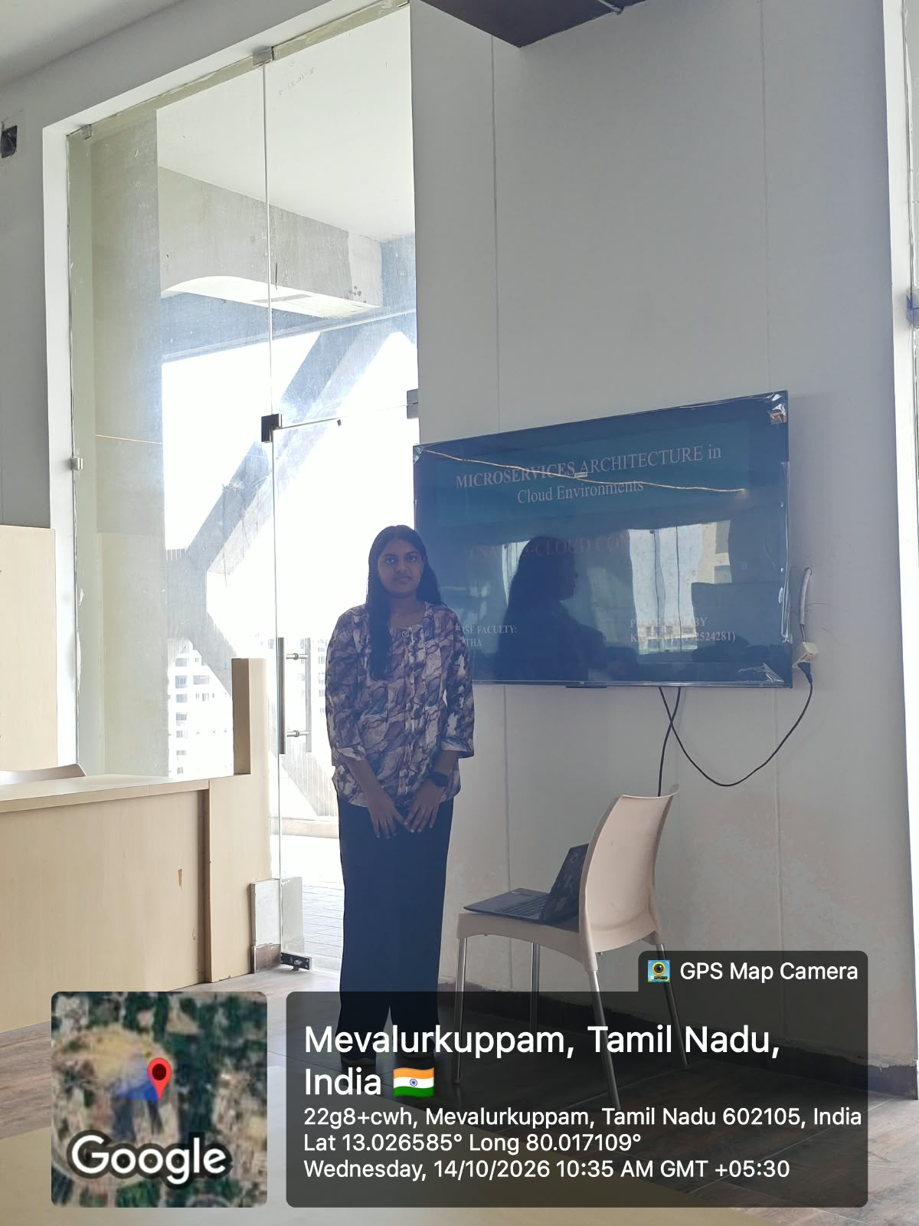

Slide 11


